Slide 1
Temperature, humidity and light detector

Slide 2
introduction
Humidity and Temperature and light are very common parameters for measuring at many places like farm, green house, medical, industries home and offices. In this IoT project we are going to Monitor Humidity Temperature and Light over the internet using ThingSpeak where we will show the current Humidity , Temperature, and Light data over the Internet using the ThingSpeak server. It is accomplished by the data communications between Arduino, DHT11 Sensor Module, ESP8266 WIFI module, a Light sensor and LCD. Celsius scale thermometer and percentage scale humidity and light meter displays the ambient temperature and humidity through a LCD display and also sends it to ThingSpeak server for live monitoring from anywhere in the world.

Slide 3
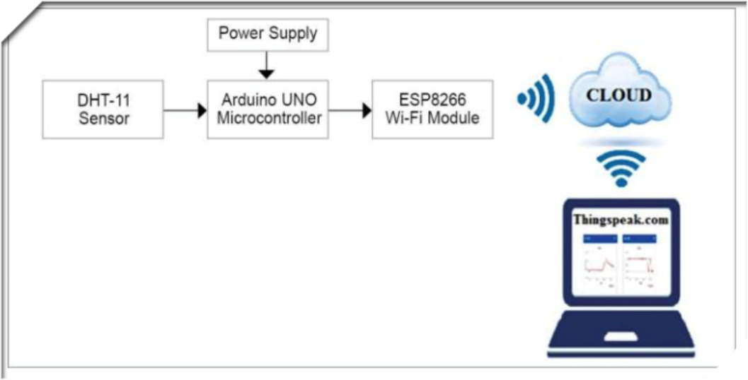
Diagram of process

Slide 4
What we completed
1. We completed the hardware part of our project.
2. That hardware is able to sense data from environment and sends them to the cloud through wifi module.
3. There are two sensors DHT 11 and a light sensor connected to the micro-controller Arduino Uno.
4. Arduino Uno is connected to Wifi module to send those data to the cloud.
5. LCD monitor is also connected to the device to see the information instantly.

Slide 5
Troubles we faced
First we built the hardware with a power adapter for supplying power.
After that the voltage controller started heating.
There were also some wiring problems.
There is a problem in our wifi module connection.
Then we built another circuit with 9v battery.
And fixed those problems

Slide 6
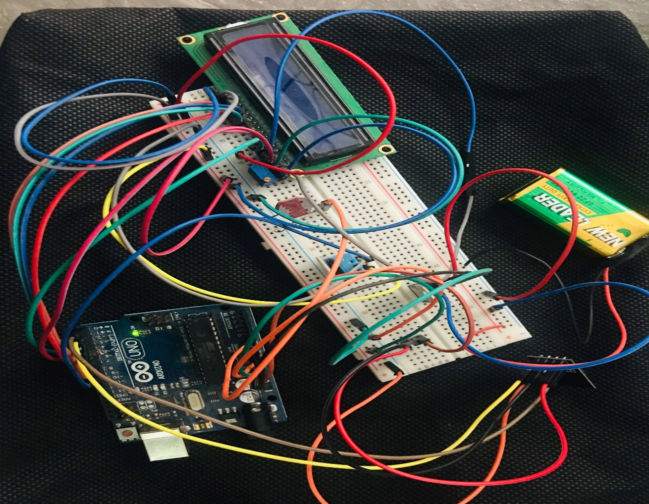
Picture of device

Slide 7
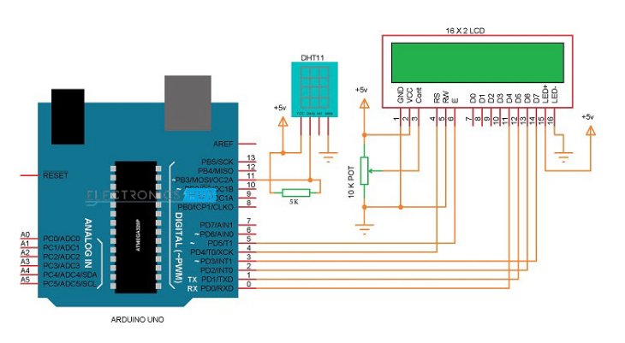
Circuit Diagram of our device
.

Slide 8
HOW THE DHT11 MEASURES HUMIDITY AND TEMPERATURE
The DHT11 detects water vapor by measuring the electrical resistance between two electrodes. The humidity sensing component is a moisture holding substrate with electrodes applied to the surface. When water vapor is absorbed by the substrate, ions are released by the substrate which increases the conductivity between the electrodes. The change in resistance between the two electrodes is proportional to the relative humidity. Higher relative humidity decreases the resistance between the electrodes, while lower relative humidity increases the resistance between the electrodes.
The DHT11 measures temperature with a surface mounted NTC temperature sensor(thermistor) built into the unit

Slide 9
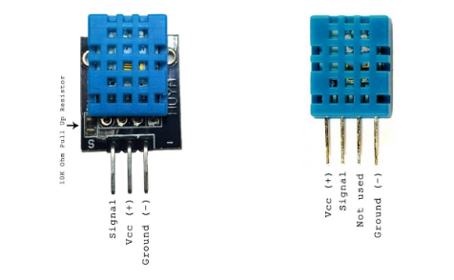
There are two different versions of the DHT11.One type has four pins, and the other type has three pins and is mounted to a small PCB. The PCB mounted version is nice because it includes a surface mounted 10K Ohm pull up resistor for the signal line and we use this PCB mounted version in our project. Here are the pin outs for both versions:

Slide 10
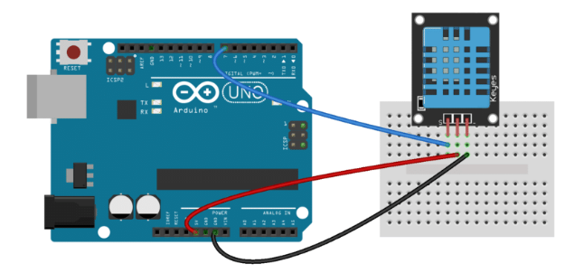
HOW TO SET UP THE DHT11 ON AN ARDUINO
Wiring the DHT11 to the Arduino is really easy, but the connections are different because its depending on which type you have.So in our device we use that has three pins DHT11 Sensor.

Slide 11
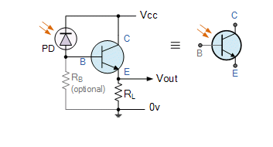
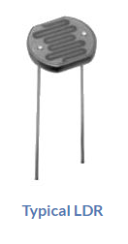
Light sensor
We also used Light Sensor in our device. Light Sensors are photoelectric devices that convert light energy (photons) whether visible or infra-red light into an electrical (electrons) signal.
In our device the Light Sensor generates an output signal indicating the intensity of light by measuring the radiant energy that exists in a very narrow range of frequencies basically called “light”, and which ranges in frequency from “Infra-red” to “Visible” up to “Ultraviolet” light spectrum.
And we know that the commonly used Photoconductive Cell is called the Light Dependent Resistor or LDR.

Slide 12
conclusion
Our project is about Temperature, Humidity and Light sensor. The objective of our project is to achieve a functional system in terms of hardware and software, to measure temperature and humidity and light.We have already completed hardware part of our project.
And we also open an account on ThingSpeak.
ThingSpeak is an Internet of Things (IoT) platform that collect and store sensor data in the cloud and develop IoT applications. The ThingSpeak IoT platform provides website that let us analyze and visualize our data in MATLAB and then act on the data.
Since our hardware connections are done, so our next approach is to add DHT22 library to ourArduino library file as described earlier.

Slide 13
Thank you

